Slide 1
Project 2 – Functional Programming
Olivia Bravo

Slide 2
Functional Programming
Functional Programming is the process of developing software using functions
In functional programming, you can’t change the variables (Immutability)
Instead of using loops, recursion can be used
Recursion – A function that can call itself
This Fibonacci program in Python will use recursion

Slide 3

Fibonacci
Input: n = 9
0, 1, 1, 2, 3, 5, 8, 13, 21
n = 1 2 3 4 5 6 7 8 9

Slide 4
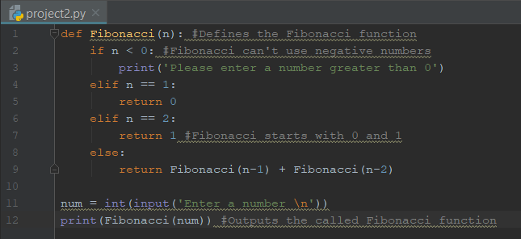




Fibonacci Program
Output:
The defined function begins in the code but does not result into the output until it is called

